Slide 1
AI Painting Agent using Deep Reinforcement Learning
CMPE 260 - Fall 2021

Slide 2
Team Members
Arun Talkad (arun.talkad@sjsu.edu)
Bhuvana Basapur (bhuvanagopalakrishna.basapur@sjsu.edu)
Mayuri Lalwani (mayuri.lalwani@sjsu.edu)

Slide 3
Outline
Problem Statement
Motivation
Challenges
Methodology
Architecture
Learning Framework
Agent/Actor
Critic
Reward
Neural Renderer
Deep Deterministic Policy Gradient(DDPG)
Implementation
Neural Renderer: Training and Results
DRL Model: Training and Results
Demo

Slide 4
Problem Statement
Train an artificial intelligence painting agent that can paint strokes on a canvas in sequence to generate a painting that resembles a given image (real world image).
Agent should have the ability to decompose the target image (handwritten digits, street view house numbers, human portraits, and natural scene images) into an ordered sequence of strokes.
Notes:
Why RL for this problem:
To handle the ill-definedness of the problem, and the long-term planning challenge, we propose using reinforcement learning (RL) to train the agent, because RL can maximize the cumulative rewards of a whole painting process rather than minimizing supervised loss at each step.
Moreover, we apply the adversarial training strategy to improve the pixel-level quality of the generated images, as the strategy has proved effective in other image generation tasks
We adopt the Deep Deterministic Policy Gradient (DDPG) which copes well with the continuous action space of the agent.
We build an efficient differentiable neural renderer that can simulate(imitate) painting of hundreds of strokes on the canvas.

Slide 5
Motivation
Painting being an important form of visual art symbolizes human wisdom and creativity.
People have to spend enormous amount of time in training to master this skill.
AI is assisting creatives in a number of ways
Assisting them in imitating the styles of renowned painters from the past.
Useful in the creation as well as in the restoration of a work.
AI-powered tools help artists be more productive and creative.

Slide 6
Challenges
We are addressing three challenges for training an agent :
Create an agent that can decompose image into sequential strokes to regenerate it on a canvas
Learning generic abstractions so that we can paint wide-range of scenarios that are not available during training
To make the learning process more efficient
Notes:
Paint like humans - Requires an agent to have ability to decompose a given target image into ordered sequence of strokes. For this the agent needs to parse the target image visually, understand the current status of the canvas and have foresightful plans about future strokes. To handle the ill-definedness of the problem, and the long-term planning challenge, we propose using reinforcement learning (RL) to train the agent, because RL can maximize the cumulative rewards of a whole painting process rather than minimizing supervised loss at each step.
Moreover, we apply the adversarial training strategy to improve the pixel-level quality of the generated images, as the strategy has proved effective in other image generation tasks.
For texture rich paintings -We design continuous stroke parameter space including stroke location, color and transparency, to improve the painting quality. Deep Deterministic Policy copes well with the continuous action space of the agent.
We built a differentiable neural renderer for efficient painting that simulate painting of hundreds of strokes on the canvas. It supports flexible stroke designs like triangle, circle and bezier curve. Moreover, the differential renderer can be combined with DDPG into a single model-based DRL that can be trained in an end-to-end fashion, which significantly boosts both the painting quality and convergence speed.

Slide 7
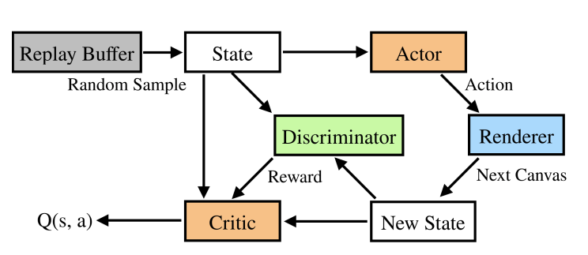
Overall Architecture
The actor outputs a set of stroke parameters based on the canvas status and target image at each step during the inference stage. The stroke is then rendered on the canvas by the renderer.
The actor is trained with the assistance of an adversarial discriminator and a critic during the training stage. The discriminator awards the reward at each step, and the training samples are drawn at random from the replay buffer.
Notes:
At the inference stage, the actor outputs a set of stroke parameters based on the canvas status and target image at each step. The renderer then renders the stroke on the canvas accordingly.

Slide 8
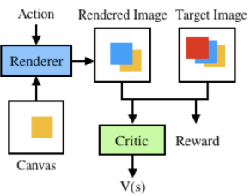
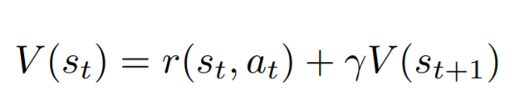
Model-based Deep Deterministic Policy Gradient
DDPG Combines DPG(Deterministic Policy Gradient) and DQN(Deep-Q Network).
DDPG is used to cope with the continuous action space of the agent.
Model-based DDPG improves efficiency by using a neural renderer to explore the environment and make informed policy updates
The critic predicts the reward without using the reward for the current action but rather using the transition function generated by the renderer

Slide 9
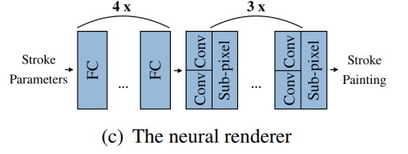
Neural Renderer
Simulates painting of hundreds of strokes on the canvas.
Differentiable Neural Renderer - For efficient painting and flexible support of different stroke, eg. triangle, circle, Bezier curve.
Neural Renderer directly maps stroke parameters to stroke paintings.
The transition function s_{t+1} = trans(s_{t}, a_{t}) is the differentiable renderer
The neural renderer is a neural network consisting of several fully connected layers and convolution layers

Slide 10
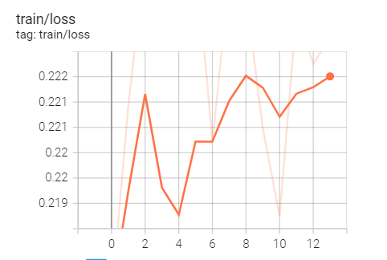
Neural Renderer: Training and Results
Input to the neural renderer is a set of stroke parameters
The output is the stroke rendered image
The strokes are quadratic beziers curves, which are differentiable
This helps with approximation while deriving gradients
Training samples are randomly generated using cv2.draw() function
Renderer is made up of Fully connected layers
The training is run for 20000 steps

Slide 11
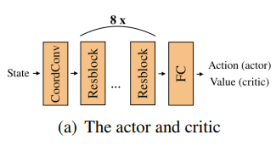
Agent /Actor
The goal of the painting agent is to decompose the given target image into strokes to recreate the image on the canvas.
The agent is designed to predict the next stroke based on observing the current state of the canvas and the target image.
Agent should maximize the cumulative rewards after finishing the given number of strokes, rather than the gain of current stroke.
The actor π(st) is trained to maximize r(st, π(st)) + V (trans(st, π(st))).
Notes:
The actor and the critic use the same structure except for the last FC layers that have different output dimensions.

Slide 12
Critic
The critic generates the expected reward for the state without including the reward caused by the current action.
It is implemented using a ResNet-18, along with a WN with a TRelU to stabilize learning
The actor and the critic use the same structure except for the last FC layers that have different output dimensions.

Slide 13
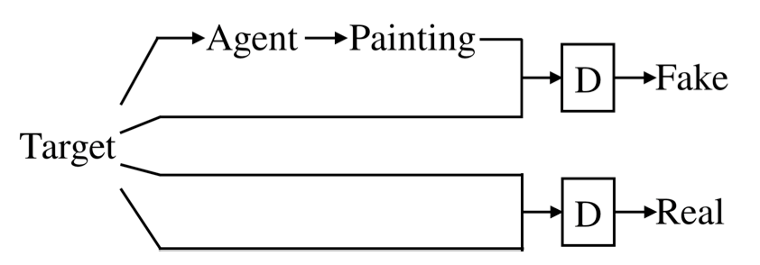
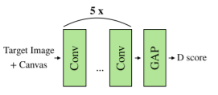
Reward
Use Wasserstein GAN (WGAN) uses the Wasserstein-l distance(also known as Earth-Mover distance) with Gradient Penalty(WGAN-GP), Where Wasserstein distance is a distance function defined between probability distributions on a given metric space
Objective of discriminator in WGAN: maxD Ey∼μ[D(y)] − Ex∼ν [D(x)]
D: Discriminator, ν and μ are the fake samples and real samples distribution
Goal is to reduce the differences between paintings and target images as much as possible.
Notes:
The discriminator in the Wasserstein GAN is used to generated the rewards. WGAN uses wasserstein distance, which is the distance function between the fake and real sample distributions, along with a gradient penalty.

Slide 14
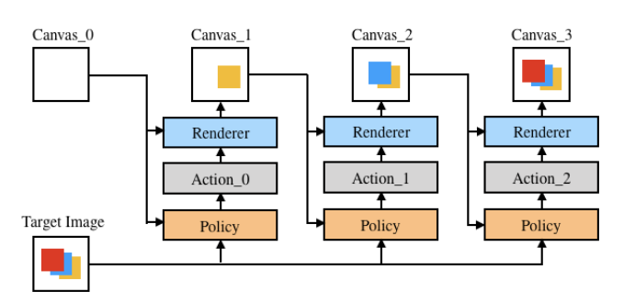
To Reiterate
Notes:
To reiterate, the actor-critic framework uses the neural renderer to learn about the environment and the discriminator to generate rewards
At the training stage,
the actor is trained with assistants of an adversarial discriminator and a critic. The reward is given by the discriminator at each step, and the training samples are randomly sampled from the replay buffer.
The actor outputs a set of stroke parameters based on the canvas status and target image at each step during the inference stage. The stroke is then rendered on the canvas by the renderer.

Slide 15
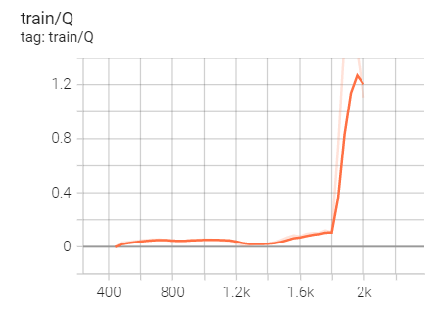
DRL Model: Training and Results
Trained the agent with 2000 images
Adam was used for optimization
Minibatch size is set to 96
Training was performed for 2000 steps
Replay memory buffer was set to 1200
Actor, Critic and Discriminator are updated after each iteration
Notes:
During the training cycle, we introduce a validation episode, that is, after every 50 training episodes, we a conduct a 5-episode validation, to ensure constant improvement in the model
The dataset is loaded into the device - which is CPU in our case.
Once the warmup phase is over, learning rates are introduced

Slide 16
Demo

Slide 17
Thank you!

